Slide 1


Plans and elevations
A solid can be drawn from various view points:
Plan view
2 cm
7 cm
2 cm
3 cm
Side elevation
Front elevation
7 cm
3 cm
3 cm
2 cm
7 cm
Notes:
Define the plan view as the view of a solid from directly above. In this example the plan view is a 2 cm by 7 cm rectangle.
Define the front elevation as the view of the solid from directly in front. In this example the front elevation is a 3 cm by 7 cm rectangle.
Define the side elevation as the view of the solid from the side. In this example the side elevation is a 3 cm by 2 cm rectangle.

Slide 2
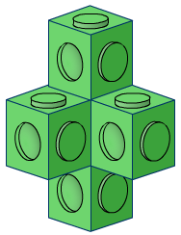
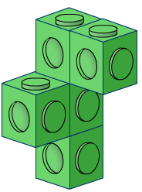
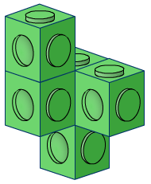
Choose the shape
Front elevation:
Side elevation:
Plan view:
A:
A:
B:
C:
Notes:
Ask pupils to choose the shape that corresponds to the three views given.

Slide 3
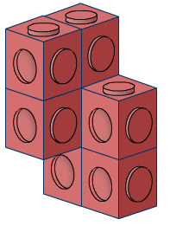
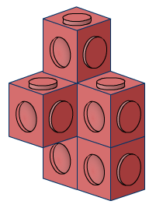
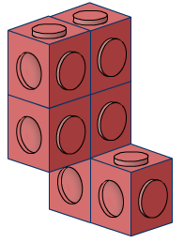
Choose the shape
Front elevation:
Side elevation:
Plan view:
A:
B:
C:
C:
Notes:
Ask pupils to choose the shape that corresponds to the three views given.

Slide 4
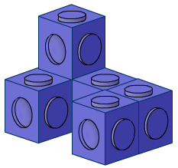
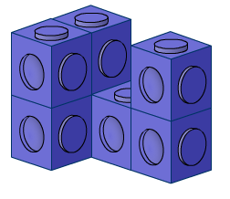
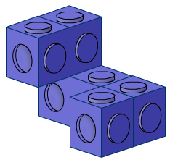
Choose the shape
Front elevation:
Side elevation:
Plan view:
A:
A:
B:
C:
Notes:
Ask pupils to choose the shape that corresponds to the three views given.

Slide 5
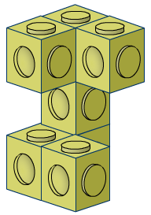
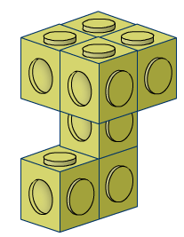
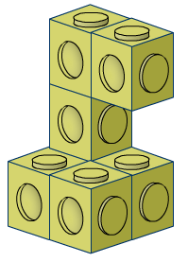
Choose the shape
Front elevation:
Side elevation:
Plan view:
A:
B:
B:
C:
Notes:
Ask pupils to choose the shape that corresponds to the three views given.

